Slide 1
AV/Voice Recording
Aditya Malik and Nathan Walls

Slide 2
Avaudiorecorder
Class that provides audio recording capabilities in your application
Record until the user stops the recording
Record for a specified duration
Pause and resume a recording
Obtain input audio-level data that you can use to provide level metering

Slide 3
Avaudioplayer
An audio player that provides playback of audio data from a file or memory
Play sounds of any duration
Play sounds from files or memory buffers
Loop sounds
Play multiple sounds simultaneously, one sound per audio player, with precise synchronization
Control relative playback level, stereo positioning, and playback rate for each sound you are playing
Seek to a particular point in a sound file; fast-forward and rewind functions
Obtain data you can use for playback-level metering

Slide 4
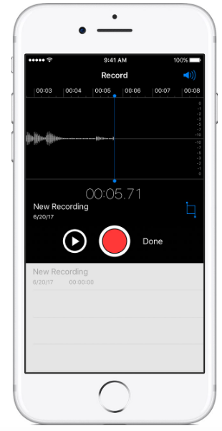
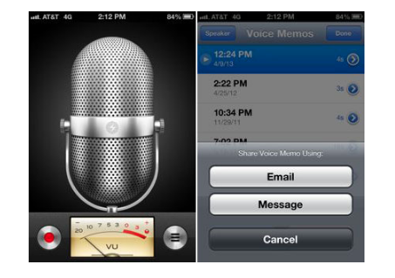
Figure 1
Figure 2

Slide 5
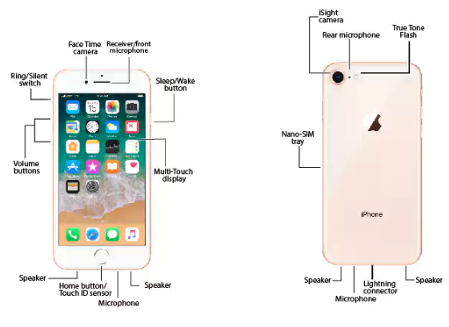
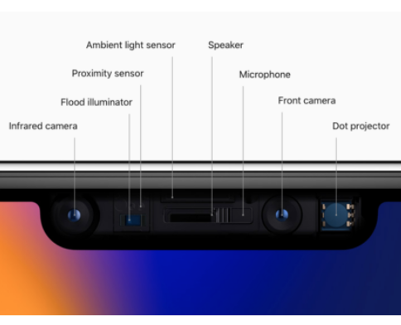
Microphone locations
iPhone 8
iPhone X

Slide 6
Popular applications
Many applications on the App Store utilize AVAudioRecorder/Player packages:
Griffin iTalk
Skype
Discord
Voice Memos
Apps earn profits by modifying the voice recordings with specific sounds, such as “Talk like a Zombie”
Other applications are more practical and used for business or company work

Slide 7
Creating a simple voice recording application
Breaks down to first setting up the AVAudioRecorder, then the AVAudioPlayer to playback the recordings
Must have permission from the user to access microphone
Recordings will be stored to device storage

Slide 8
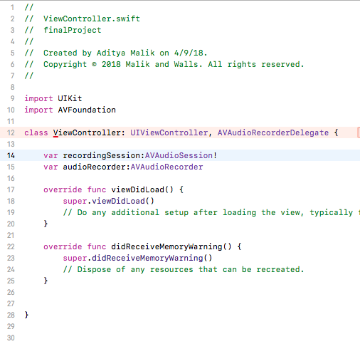
Code for avaudiorecorder + permission
Delegate to allow us to record some audio
Audio recording session and audio recorder responsible for recording our audio

Slide 9
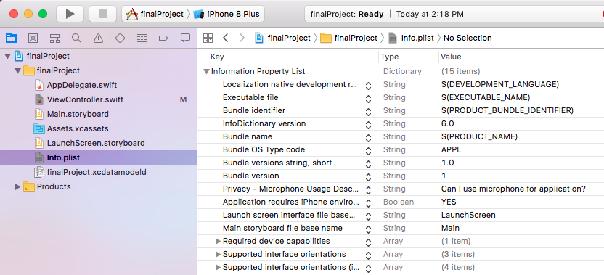
Code for avaudiorecorder + permission
Asking the user for mic permission

Slide 10
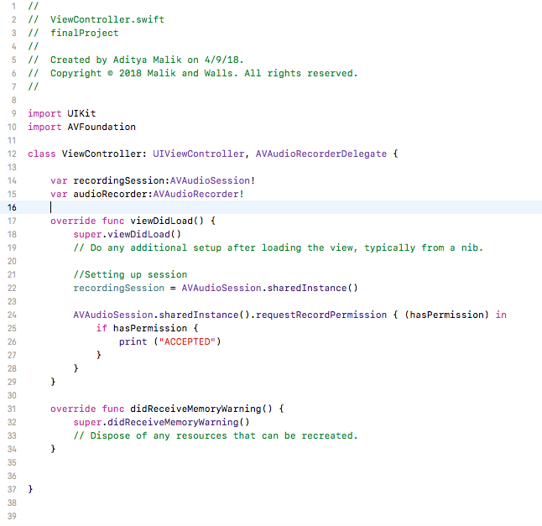
Set up recording audio session
Request permission
Once we have it, we can continue by giving user a button to record

Slide 11
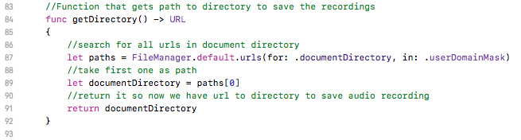
Now write function to get the directory path where we are going to save our recordings.
This function will get us the path to our directory.
1) Search for all URLs in our documents directory
2) Take the first one as our path
3) Return the URL to the directory for where we are going to save our audio recording

Slide 12
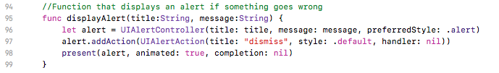
Good Code Behavior: Display an alert if something goes wrong
This will simply display a message if something goes wrong and present it to the user

Slide 13
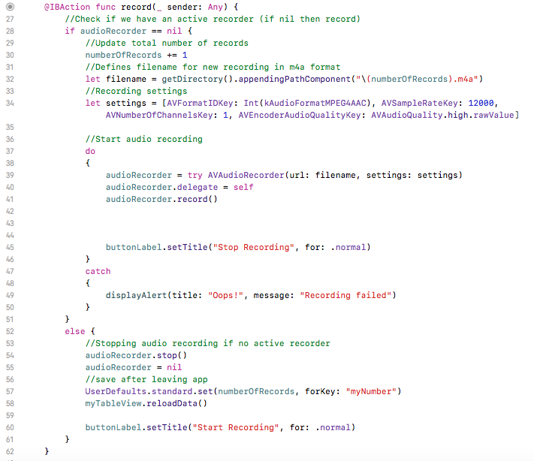
First check to see if we have an active audio recorder. If we don’t, then we want to start recording one.
Increment total number of voice records (useful for naming the recordings to keep track) and name file with directory function 1) Get general path to directory from function 2) Add the name of the recording (which is numberOfRecords) 3) Add .m4a for audio file

Slide 14
Our Audio Settings for the voice recordings
AVFormatIDKey – Formats the voice recordings (MPEG in this case)
AVSampleRateKey – Sample rate of voice recording in Hertz
AVNumberOfChannelsKey – Number of channels of voice recording
AVEncoderAudioQualityKey – Sets sample rate conversion quality (high in this case)

Slide 15
Do-catch for starting audio recording; if it fails then we can display alert
Initialize our audioRecorder and set it equal to try AVAudioRecorder, and url is simply our file location where we will save it, and settings we defined earlier
Add delegate which is just self since we added it in our class
Begin record and set button title from “Start Recording” to “Stop Recording”
If audio recording failed, display alert message using function made earlier

Slide 16
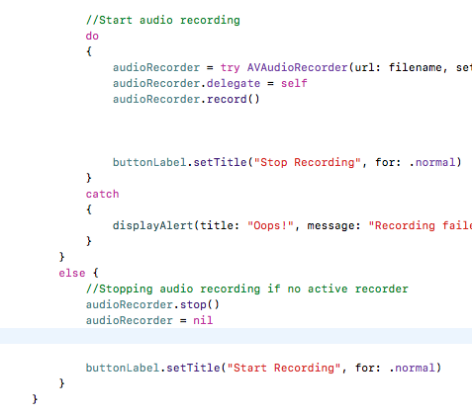
If we already have an active audio session, we want to:
Stop the audio recording
Set the audio recorder to nil
Set the button title back to “Start Recording”

Slide 17
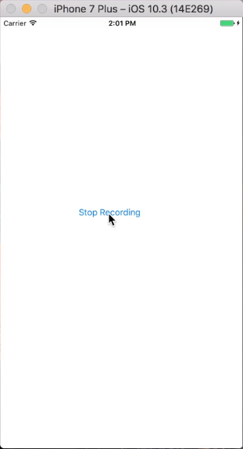
So this sets up the voice recorder, but now we need a way to play back the audio or else we don’t know what we are recording!

Slide 18
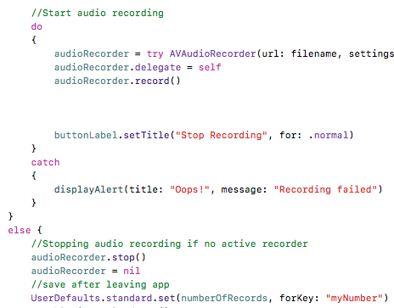
We want to make sure that every time we open the application, the files saved are unique numbers so none of the recordings get overridden. (ex. If we always start with recording 0, we will keep overriding)
So once we have stopped the recording and made sure it is complete, then we save the last recording as our user defaults value

Slide 19
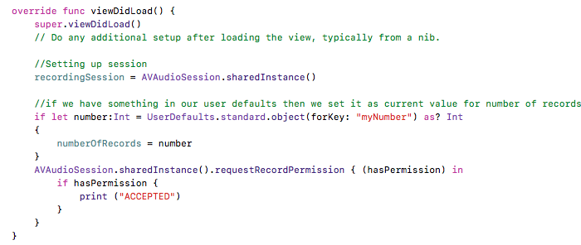
We want to retrieve that each time we re-open the application, so we will retrieve that number in our viewDidLoad() function
Basically if we have something in our user defaults when we launch, then we are taking that number, casting it to an integer, and setting that as the current value of number of records so we are up to date and no files are overridden

Slide 20
Now we want to create a table view to hold all of our recordings

Slide 21
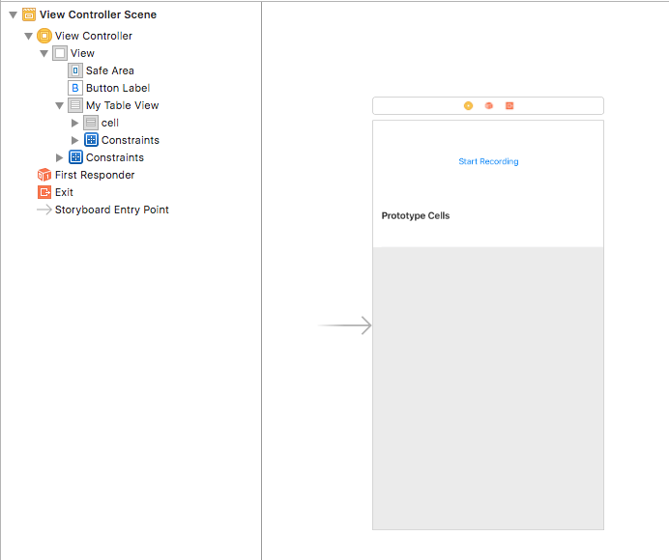
First add a Table View to hold all the recordings in the main storyboard controller

Slide 22
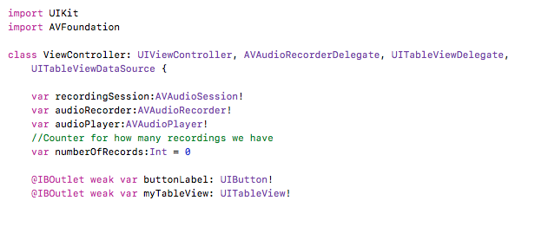
Then link it to our main ViewController code

Slide 23
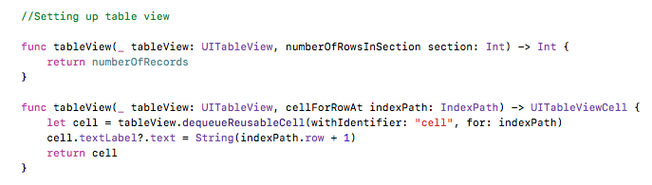
Now we want to set up our table view.
Function to make a row for each recording that we have
Function that creates a cell and then populate each cell with the content for the number of the recording (ie. If we have 3 recordings, we have a three cell with “1”, “2”, and “3”

Slide 24
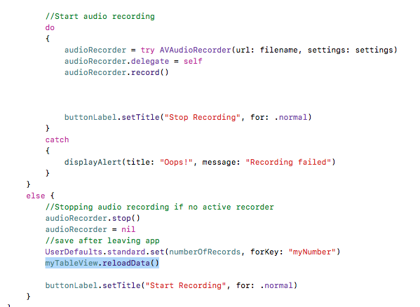
We want to refresh our table view after we have finished a recording (do this in the audio recording)

Slide 25
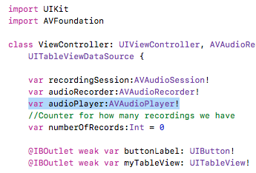
Lastly we want to create the audio listener function
First define an audio player variable

Slide 26
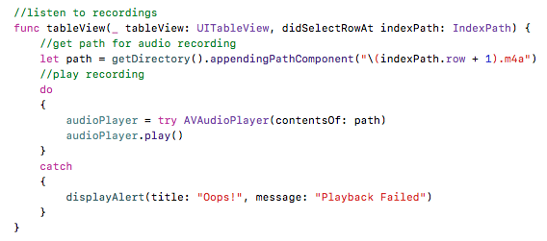
Registers user’s tap on the row
Function to listen to our recordings on tap in our table view
Get path to the audio recording
Use Do-Catch to play the audio in the path
Display alert if something goes wrong

Slide 27
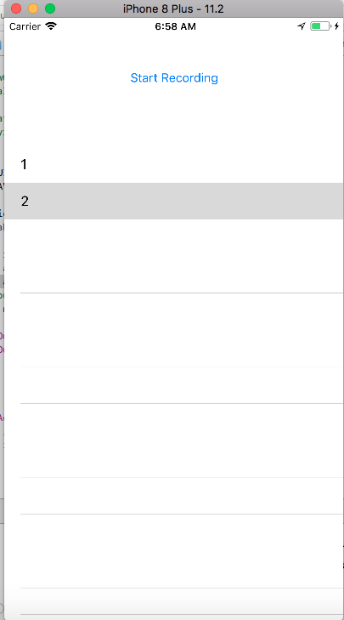
Done! Now Test!

Slide 28
Thank you!

